Slide 1

DAILY SCREEN TIME USAGE
Daniel S. Kouassi

Slide 2
STEP STUDY

Slide 3
QUESTION
What affects my daily screen time usage ?
Does it depend on whether it’s a workday or not ?

Slide 4
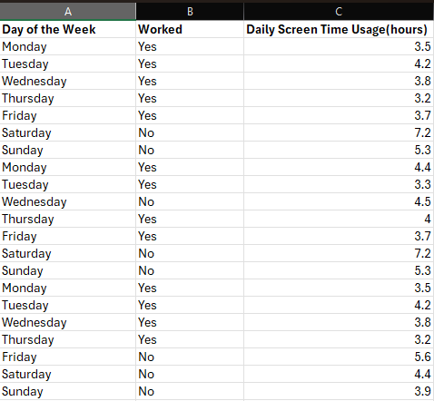
DATA
21 Days of Observations
Variables :
Day of the Week
Worked (Yes/No)
Daily Screen Time Usage (hours)

Slide 5
HYPOTHESIS TESTING
Claim : The mean daily screen the time usage on workdays is less than the mean daily time usage on non-workdays.
Variables:
Dependent: Daily screen time usage
Independent: Worked (Yes/No)

Slide 6
HYPOTHESIS TESTING
Step 1
Null Hypothesis: The mean daily screen time usage on workdays is not significantly different from the mean daily screen time usage on non-workdays.
Alternative Hypothesis: The mean daily screen time usage on workdays is less than the mean daily screen time usage on non-workdays.

Slide 7
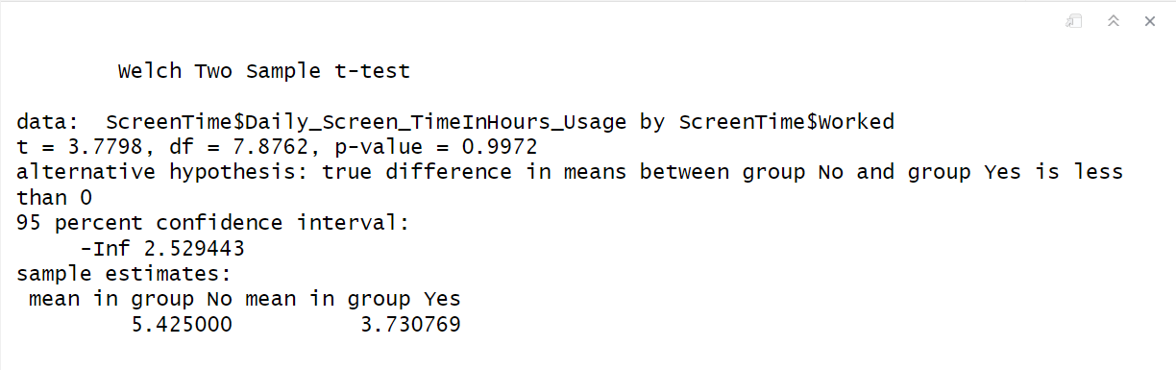
HYPOTHESIS TESTING
Step 2
Use t –test
Step 3
Test Statistic
T = 3.7798
P-value = 0.9972
Step 4
Using a significance level of 0.05,we fail to reject the null hypothesis.

Slide 8
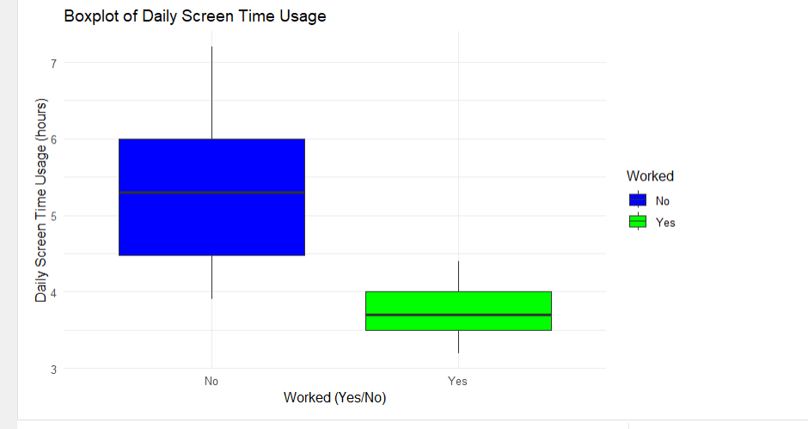
CONCLUSION
Since the p-value, 0.9972, is greater than 0.05, we fail to reject the null hypothesis. There is no significant evidence to conclude that the mean daily screen time usage on non-workdays is less than the mean daily screen time usage on workdays.

